Slide 1
Lesson 1 – Homework review

Slide 2
Invite all reviewers
olexandr.kucher
y.brahinets
Vrudas
InnaBakum
mudrenko.vlad
michaelsav4enko

Slide 3
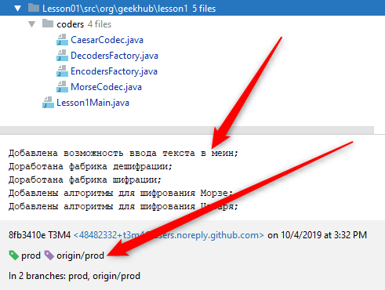
Follow Git convention: commit message

Slide 4
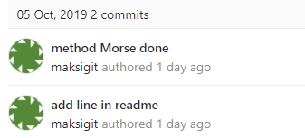

Follow Git convention: contributor

Slide 5
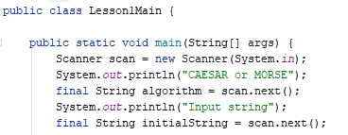
Do not change home task

Slide 6
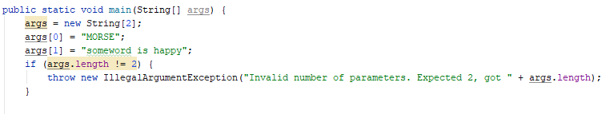
Do not change home task

Slide 7
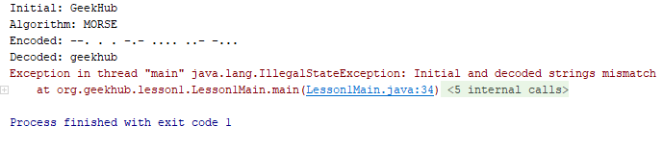
Program should complete successfully

Slide 8
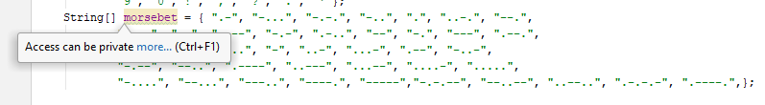
Pay attention on IDE warnings

Slide 9
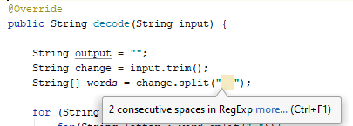
Pay attention on IDE warnings

Slide 10
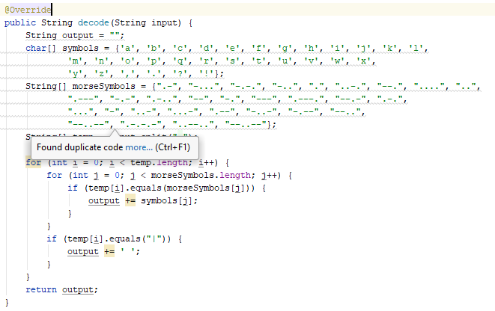
Pay attention on IDE warnings

Slide 11
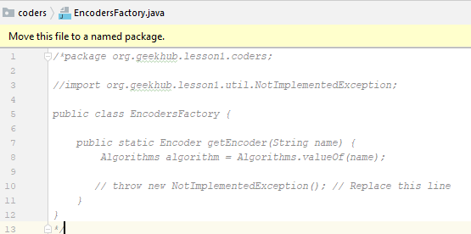
Remove unused code

Slide 12
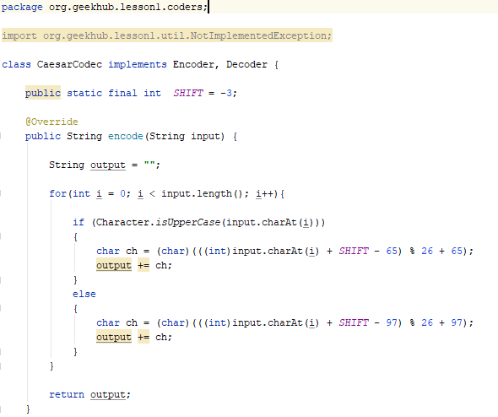
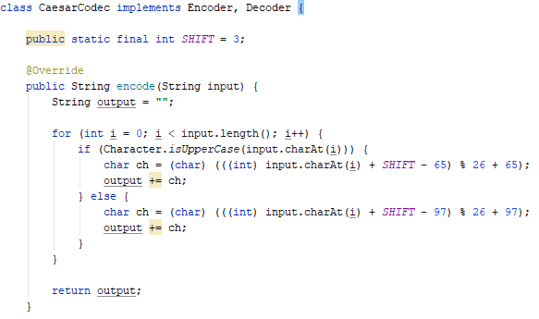
Format code
CTRL+ALT+O – remove unused imports
CTRL+ALT+L – format code

Slide 13
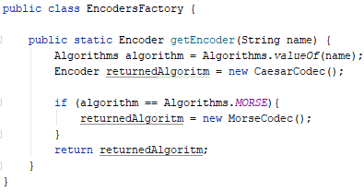
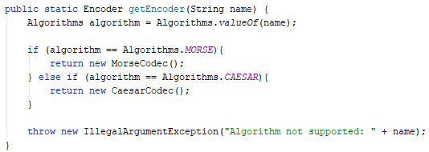
Avoid reassignment

Slide 14
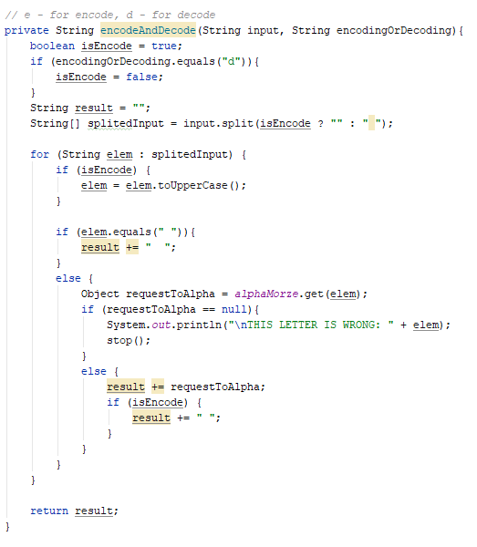
KISS; Single Responsibility

Slide 15
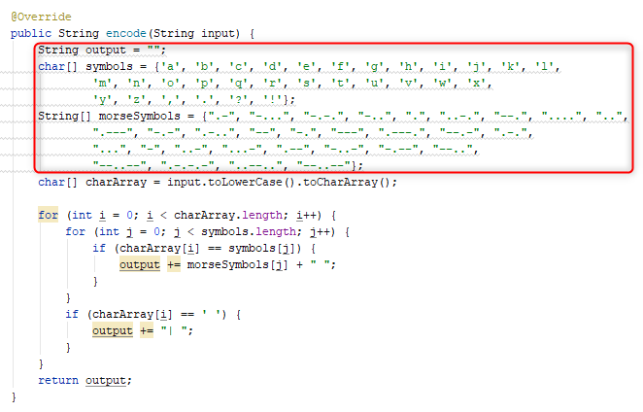
Use constants

Slide 16
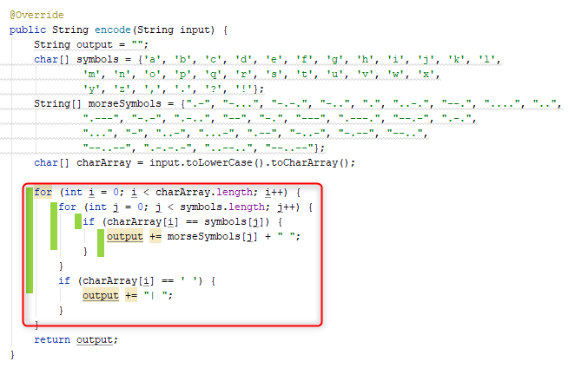
Extract sub methods

